Slide 1
SAP Summer School
The ABAP Workbench. ABAP development

Slide 2

Course Agenda
ABAP Workbench
Basic ABAP Language Elements
Using Internal Tables
Modularization with Function Modules

Slide 3
Workbench Tools
1. ABAP Workbench
Navigation:
Object Navigator (SE80)
ABAP-Development:
ABAP Dictionary (SE11)
ABAP Editor
Class Builder
Function Builder (SE37)
Screen Painter
Menu Painter
Programming environment
Maintenance of text elements
Version Management
Maintaining message classes (SE91)
Analysis tools:
ABAP debugger
Runtime analysis
SQL-Trace
Modifications:
Modification assistant

Slide 4
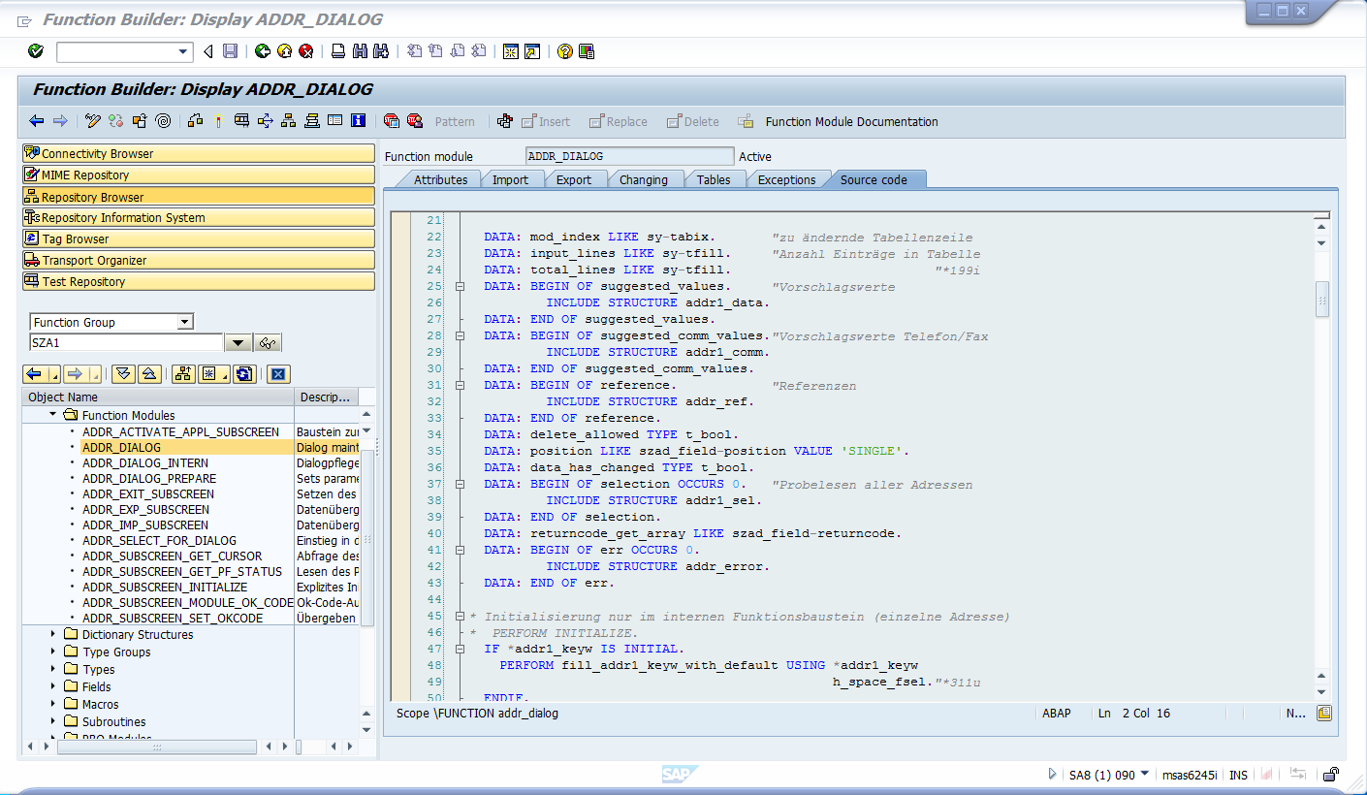
SE80 – Object Navigator
1. ABAP Workbench

Slide 5
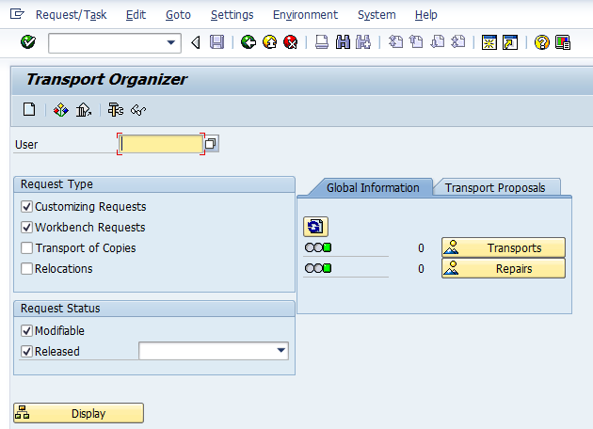
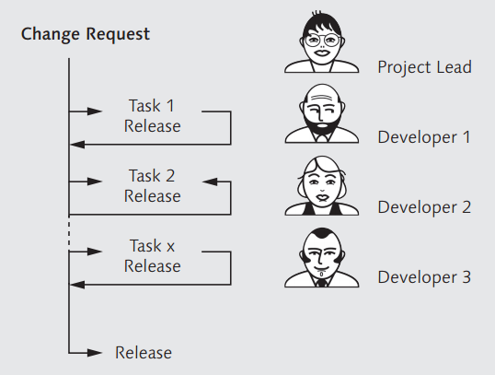
The Concept of Transport
1. ABAP Workbench
Customizing and changed or newly created objects are transferred to other systems in the landscape through transports.
Various changes are grouped into multiple tasks, each of which is assigned to one user.
Notes:
All transports (both exports and imports) take place in several steps, each of them being logged.

Slide 6
Basic ABAP Syntax
2. Basic ABAP Language Elements
ABAP is a programing language developed by SAP for programming business applications within the SAP environment.
The ABAP programming language:
is strongly typed
supports internationalization
provides integrated database access through Open SQL
supports both procedural and object-oriented programming
is platform-independent
Exposes functionality to external systems through Remote Function Calls (RFC)
General rules:
ABAP programs consist of individual statements
Each statement ends with a period “.”
Words must always be separated by at least one space.

Slide 7
Built-in Data Types
2. Basic ABAP Language Elements
Data type | Description | Length
Numeric Types
i | Integer | Fixed, 4 bytes
f | Floating point number | Fixed, 8 bytes
p | Packed number | Fixed, 1 – 16 bytes
Character Types
c | Character | Fixed, 1 - 65535 bytes
d | Date (YYYMMDD ) | Fixed, 8 bytes
n | Numeric text field | Fixed, 1 - 65535 bytes
t | Time (HHMMSS) | Fixed, 6 bytes
Strings
string | Character string | Variable
xstring | Byte string | Variable
TYPES <type_name>..
DATA <var_name> TYPE <type_name>.
Notes:
Nu a mai incaput Hexadecimal field (X)

Slide 8
2. Basic ABAP Language Elements
Transparent tables
Database tables
Field 1
…
Field n
Data Dictionary
Data Element
Predefined data type
Domain

Slide 9
Global vs. Local Data Types
2. Basic ABAP Language Elements
Data types can be defined locally in the ABAP program or globally in the Data Dictionary (SE11).
Advantages of globally defined data types:
Consistency and maintainability through usage in all of the repository
Technical information can be displayed (F1-Help, F4-Search Help)
Example
Table: STUDENTS
Field: AGE
Table: TEACHERS
Field: AGE
Table: CARS
Field: AGE
Semantic attributes, such as field meaning and documentation
Data Element: AGE
Technical attributes like data type, length, and decimal places
Domain: DECIMAL

Slide 10
Keywords
2. Basic ABAP Language Elements
ABAP - Keyword
Operands (according to keyword)
Point as delimiter of the ABAP statement
DATA:
ls_person
TYPE
ZPERSON
.
SELECT
* FROM ZPERSONS
INTO CORRESPONDING FIELDS OF ls_person
WHERE NAME LIKE ‚John%‘
.
WRITE
ls_person-CNP.
WRITE ls_person-SURNAME.
WRITE ls_person-NAME.

Slide 11
Comments
2. Basic ABAP Language Elements
Double quote marks (“) indicate that the remainder of a line is a comment.
Asterisk (*) at the beginning of the line indicates that the whole line is a comment.
REPORT z_lecture_2. DATA ls_period TYPE /msg/rvtgper. * Comment with asterisk
START-OF-SELECTION. SELECT * FROM /msg/rvtgper " Comment with double quotes INTO CORRESPONDING FIELDS OF ls_period. NEW-LINE. WRITE: ls_period-vtgnr, ls_period-vtgjj, ls_period-status. ENDSELECT.
Start of the event block

Slide 12
System Fields
2. Basic ABAP Language Elements
Accessible from all ABAP programs
Filled by the runtime environment
Indicate the state of the system at any given point of time
Individual fields can be accessed by using „sy-<name_of_field>“
Common system fields:
Name | Description | Example value
SUBRC | Return code set by many ABAP statements | 0 – success; other value - fail
UNAME | Logon name of the user | „POPESCUI“
DATUM | System date | 24.12.2015
UZEIT | System time | 14:24:02
INDEX | Loop index (including the current pass) | 3
LANGU | Single-character language key | „E“, „D“, „F“
Complete list of system fields: https://help.sap.com/saphelp_46c/helpdata/en/7b/fb96c8882811d295a90000e8353423/content.htm

Slide 13
Example of an existing program
2. Basic ABAP Language Elements
Definitions:
Executable source code:
DATA lt_persons TYPE TABLE OF ZPERSON. " Single data definition
DATA: ls_person, ls_student TYPE ZPERSON. " Chained data definitions
PARAMETERS pa_cnp TYPE ZCNP.
START-OF-SELECTION.
SELECT SINGLE * FROM zperson
INTO CORRESPONDING FIELDS OF ls_person
WHERE username = sy-uname.
IF sy-subrc = 0.
MOVE-CORRESPONDING ls_person TO lt_persons.
CALL SCREEN 100.
WRITE: ls_person-cnp,
ls_person-surname,
ls_person-name.
ENDIF.

Slide 14
ABAP Processing Blocks
2. Basic ABAP Language Elements
Each ABAP program is divided into processing blocks. The possible processing blocks are:
Procedures:
Methods
Function modules
Subroutines
Dialog modules (used exclusively for Dynpros)
Event blocks

Slide 15

SELECT…ENDSELECT
2. Basic ABAP Language Elements
The ENDSELECT statement closes a loop started with SELECT.
It provides a looping mechanism, iterating over all rows of the result
Worse performance than SELECT…INTO TABLE!
Example with ENDSELECT:
DATA: ls_person TYPE zpersons_row. SELECT * FROM zpersons INTO ls_person. WRITE: ls_person-name,
ls_person-age. ENDSELECT.
DATA: lt_persons TYPE zpersons_itab, ls_person TYPE zpersons_row. SELECT * FROM zpersons INTO TABLE lt_persons. LOOP AT lt_persons INTO ls_person. WRITE: ls_person-name, ls_person-age. ENDLOOP.

Slide 16
Controlling the Program Flow – Control Structures
2. Basic ABAP Language Elements
IF/ ELSE Instruction
IF <expr>.
...
ELSE.
...
ENDIF.
CASE-WHEN
CASE variable.
WHEN value1.
...
WHEN value2.
...
WHEN OTHERS.
...
ENDCASE.

Slide 17
Controlling the Program Flow – Loop (iteration)
2. Basic ABAP Language Elements
A loop consists of a statement block that is defined by control statements such as DO or WHILE and can be executed several times.
SELECT … ENDSELECT.
DO [n TIMES] … ENDDO. (unconditional loop)
WHILE condition. … ENDWHILE.
The statement block is executed until it reaches a termination statement such as EXIT. After this statement, the loop is terminated, and processing resumes after the closing structure of the loop (ENDDO, ENDWHILE, ENDSELECT).
You can skip to the next iteration of the loop using the CONTINUE statement.
More examples can be found in the ABAP official documentation.

Slide 18
Processing Internal Data - Internal Tables
3. Using Internal Tables
Internal table = ARRAY of [ STRUCTURE- ] TYPE
Vector: DATA: lt_vector TYPE TABLE OF i.
Matrix:
TYPES: t_vector TYPE TABLE OF i.
DATA: lt_matrix TYPE TABLE OF t_vector.

Slide 19
Working with Internal Tables
3. Using Internal Tables
Append
Insert
Read
Modify
Delete
APPEND wa TO itab.
INSERT wa INTO itab <condition>.
READ TABLE itab INTO wa <condition>.
MODIFY itab FROM wa [ <condition> ].
DELETE itab <condition>.

Slide 20
Working with Internal Tables
3. Using Internal Tables
LOOP AT itab INTO wa <condition>.
ENDLOOP.
Loops: for every single operation
Deleting multiple lines
Inserting multiple lines
Appending multiple lines
DELETE itab <condition>.
INSERT LINES OF itab2 INTO itab1.
APPEND LINES OF itab1 TO itab2.

Slide 21
Modularization Techniques – Function Modules
4. Modularization with Function Modules
Function modules (FMs) are procedures that are defined in special ABAP programs only, so-called function groups, but can be called from all ABAP programs.
FMs allow you to encapsulate and reuse functionality within the SAP system.
Each FM can be defined by its parameters (import, export, changing, tables and exceptions).
The OPTIONAL parameters do not need to be supplied during the call of a FM
[↓] Import parameters
[↑] Export parameters contain the results returned from the FM execution
[∆] Changing parameters indicate those parameters whose values are changed in the FM
Table parameters contain the internal table that you want to pass in the FM
[!] Exceptions are the errors or some exceptions that might have occurred during the FMs execution

Slide 22
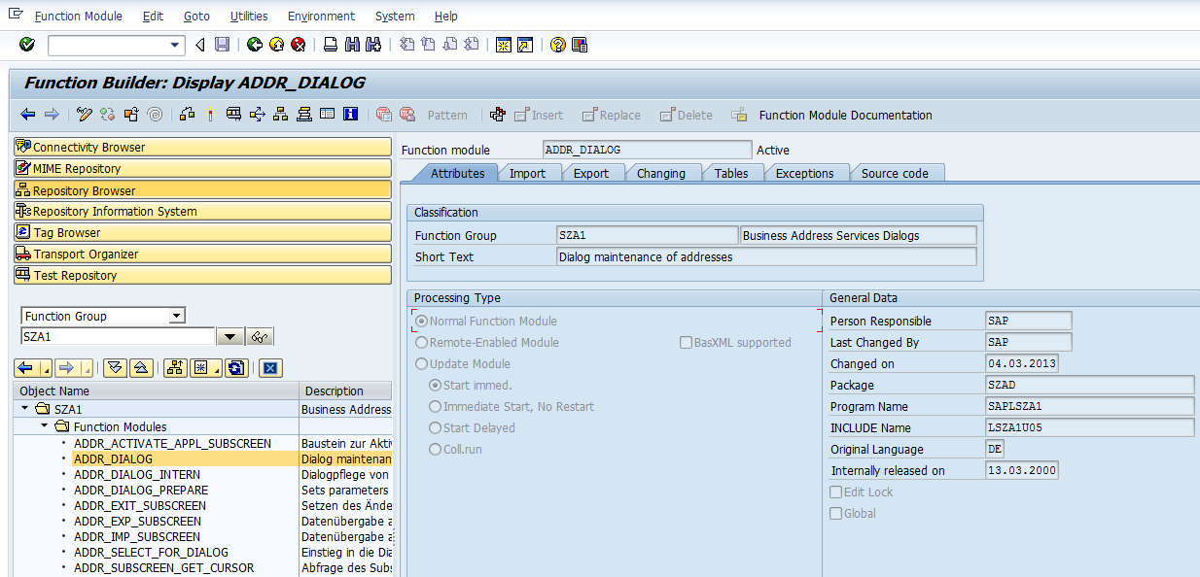
Function Modules (FM, RFC) - Visibility
4. Modularization with Function Modules
FM ADDR_DIALOG can be called in order to maintain the address of any person that exists in your SAP system.

Slide 23
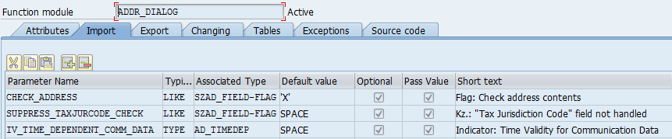
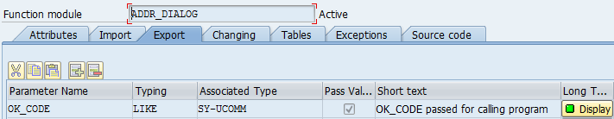
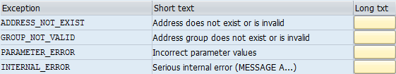
Function Modules (FM, RFC) - Parameters
4. Modularization with Function Modules
Importing parameter
Exporting parameter
Exception parameter

Slide 24
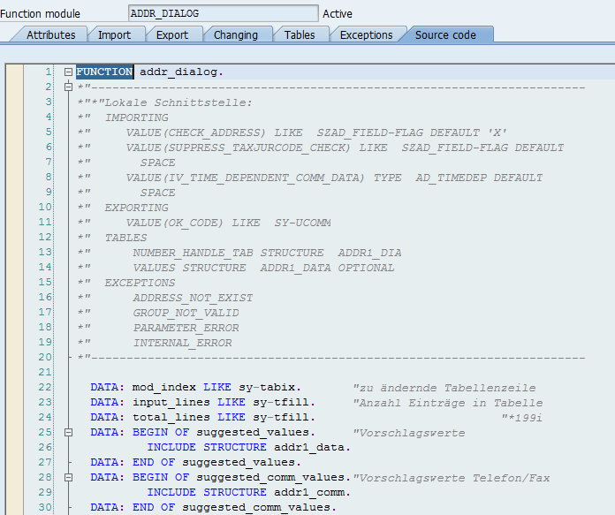
Function Modules (FM, RFC) – Source Code
4. Modularization with Function Modules

Slide 25


